Slide 1

Untitled
Muhammad Noor ( 05111850010003 )

Slide 2
Basic Componen

Slide 3
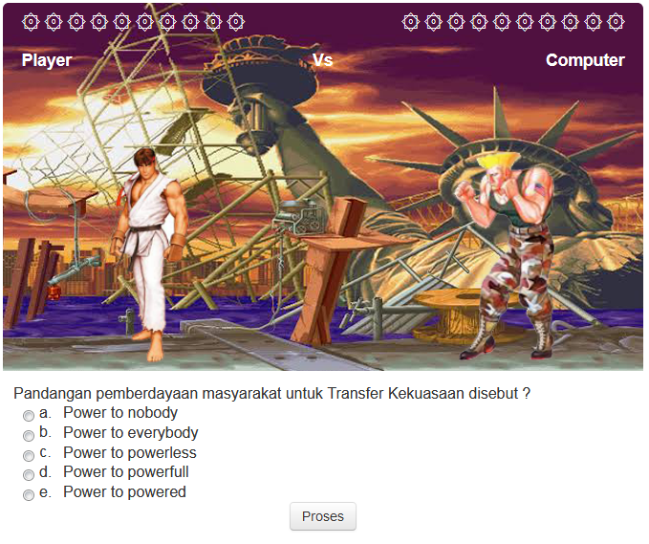
A. Game Space
A full-screen web-page that shows the board games, question, and process button.

Slide 4
B. Boundaries
The Game plays when the participant clicks the start button.
The board game that must be finished by the participant with answering the questions correctly.
Scoring based on the quality of answers.

Slide 5
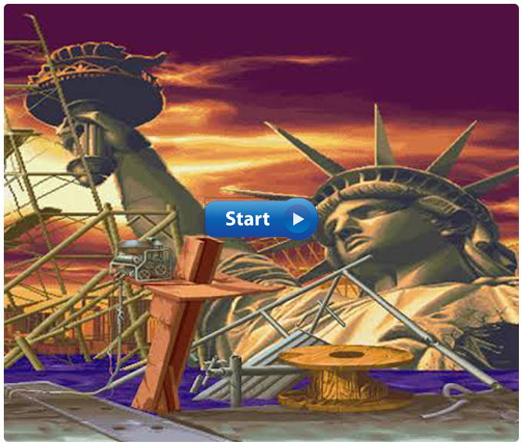
C. Rule for Interaction
Click the start button.

Slide 6
C. Rule for Interaction (Cont.)
Participants can begin the game by answering the question that appears. Choose the answer and press process button to check the answer.

Slide 7
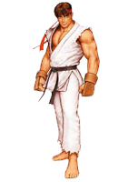
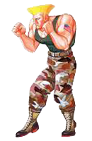
D. Artifacts
Player Vs Computer

Slide 8

D. Artifacts (Cont.)
Health

Slide 9
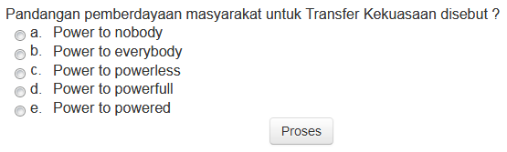
D. Artifacts (Cont.)
Question

Slide 10
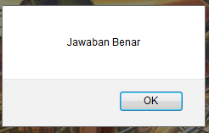
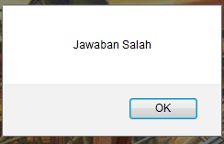
D. Artifacts (Cont.)
Correct or Wrong Answer

Slide 11
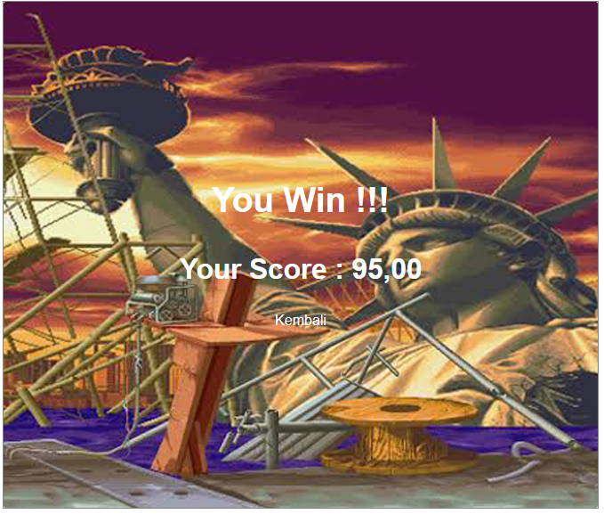
D. Artifacts (Cont.)
Result

Slide 12
Terima Kasih Matur Nuwun Hatur Nuhun Thank You Shukraan Lak Danke XieXie Dhanyavaad Arigato Bedankt Grazie Gomawo Merci Blagodaryu Vas Gracias

